Slide 1
GeeksHUB A Workspace and a second home
Presented to you by the geeks

Slide 2
Contents of our Presentation
01
02
03
04
05
What is GeeksHub
The move
To digital
Our Tools
Database Structure
System Structure

Slide 3

Let’s dive in

Slide 4
01
What is GeeksHub

Slide 5
Workstation
Workstation
Why is it useful
A workstation is a place where students go to study or work on projects, it is mostly located nearby schools or univesties to provide a second home for the students to study.
Students need a place to work on projects together, and a place to study together inbetween classes, a workstation provides both for students.

Slide 6
What does GeeksHub provide
Meeting Rooms
3D Printing
Monthly Subscription
Multiple meeting rooms in different sizes for project meetings or group studying.
More than one 3D printer for all the engineers needs with different colors and filliments.
For students who often go to workspace they have Monthly subscriptions with cheaper prices than one time sessions, to support students.

Slide 7

02
The move to Digital

Slide 8
The move to Digital
Things used to be written down and kept track of using pen and paper, but as the world changes so must we
GeeksHub used to keep track of the time of users who come in and the daily and monthly income using pen and paper, also used to keep track of employees using excel sheets
We presented our project to make a website that keeps track of all of this for them

Slide 9
03
Our Tools

Slide 10
Why use Frameworks
More efficient
Stable and easy to maintain
Build a project from the ground
up while frameworks and
templates exit is less efficient and
more work for the same job
Frameworks are far more stable
than pure projects where you
have to deal with pure data
And it is way easier to maintain

Slide 11
The React Framework
Very Popular
Very Fast
The React framework is being used by millions of people which provide us with a lot of documentations and support
The React framework is very fast and efficent to work which keeps costs low and performance high
Easy to Scale
Very Stable
The React framework is one of the easiest framworks to scale from small projects to indsutry level projects, which makes it good to start your project with, and stick with it to the end
The React framework is very stable and has a lot of saftey measures, so it doesn’t crash, which makes it very optimal for servers

Slide 12
The Firebase bbcs
Google
No coding
The Firebase bbcs is owned
and supported by Google one of
the biggest companies when it
comes to cloud services
When using Firebase you don’t
have to write any lines of code
all of its tools are interface
based making setting it up your
database easier than ever
Free
Easy Integration
Firebase is a free to use backend
database service which provides
you a ton of free tools to use in
setting up your database
The Firebase bbcs easily
Integrates with all popular
frameworks and works very well
with React

Slide 13
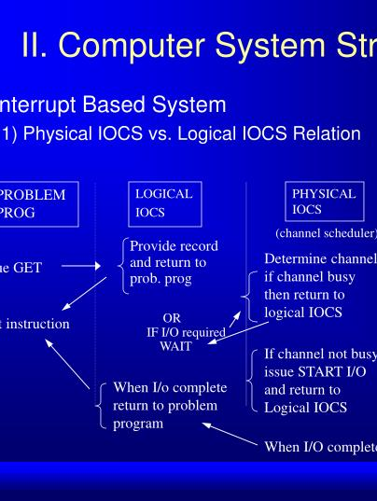
04
System Structure

Slide 14
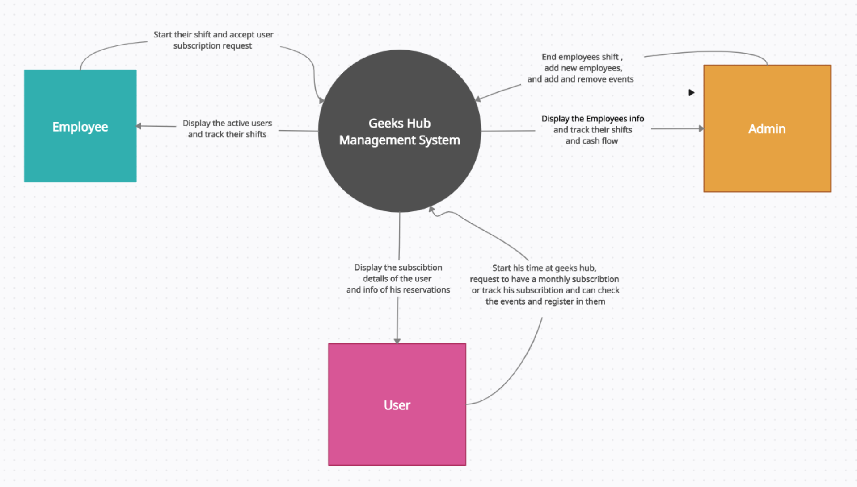

Slide 15

05
Database Structure

Slide 16
Database Structure
Class Events
Class User
Class CashPerDay
Attributes
-Event ID
-Event Name
-Event Reg Link
-Event IMG
Attributes
-Name
-Email
-Phone Number
-Faculty
Attributes
-CashCollected
-Number of Reserva
Admin is a user
Employee is a user
Class Employee
Class Admin
Attributes
-IsEmployee
-NumberOfShiftsThisMonth
-NumberOfShiftsPreviousMonth
-Salary
-IsWorking
Attributes
-IsAdmin (true)

Slide 17
—The Geeks
Thank you for listening

